Slide 1

Stata: Introduction and Basics
John McDonnell
Sarah Worley
Wei Liu

Slide 2
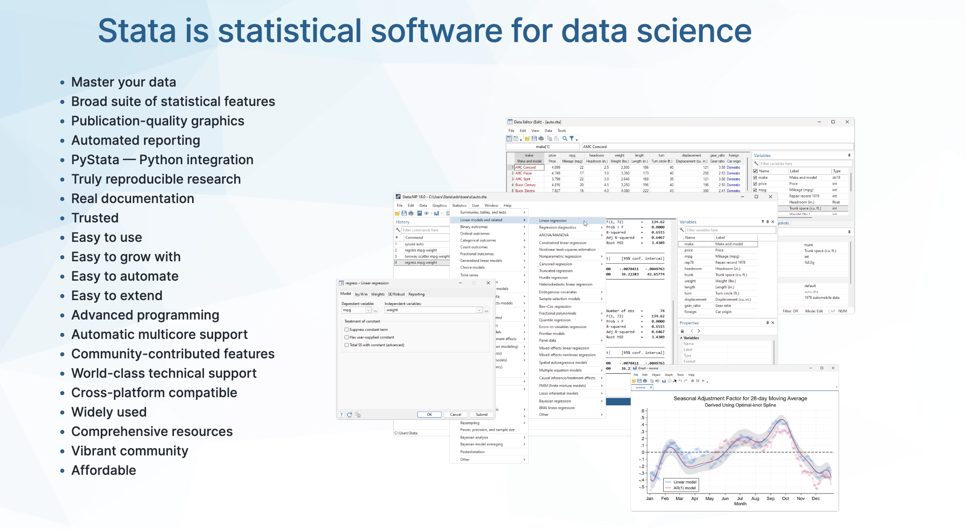
What is Stata?

Slide 3
Why Stata?
Easy to use
Good for reproducibility
Integrates well with other platforms

Slide 4
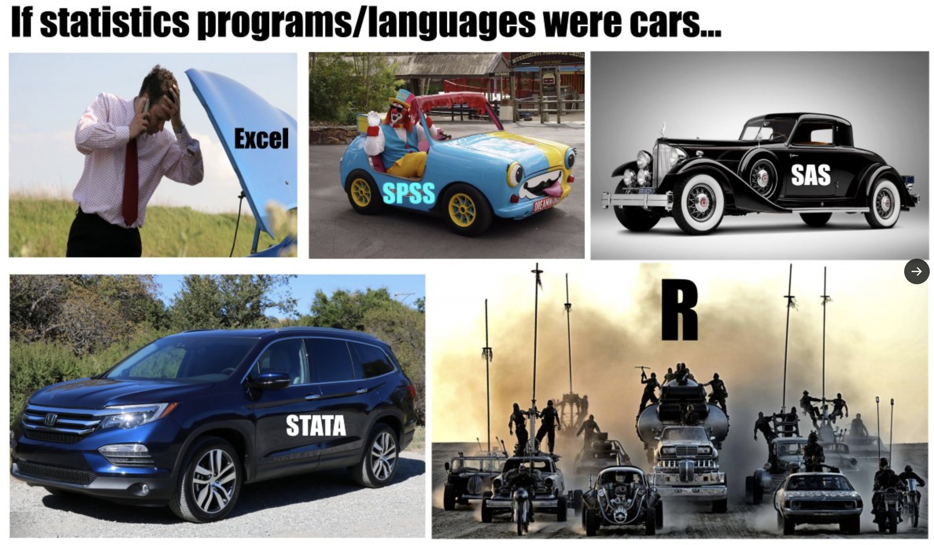

Source:

Slide 5
Course Materials
https://github.com/JACKMCDONNELL/Stata-fellows

Slide 6
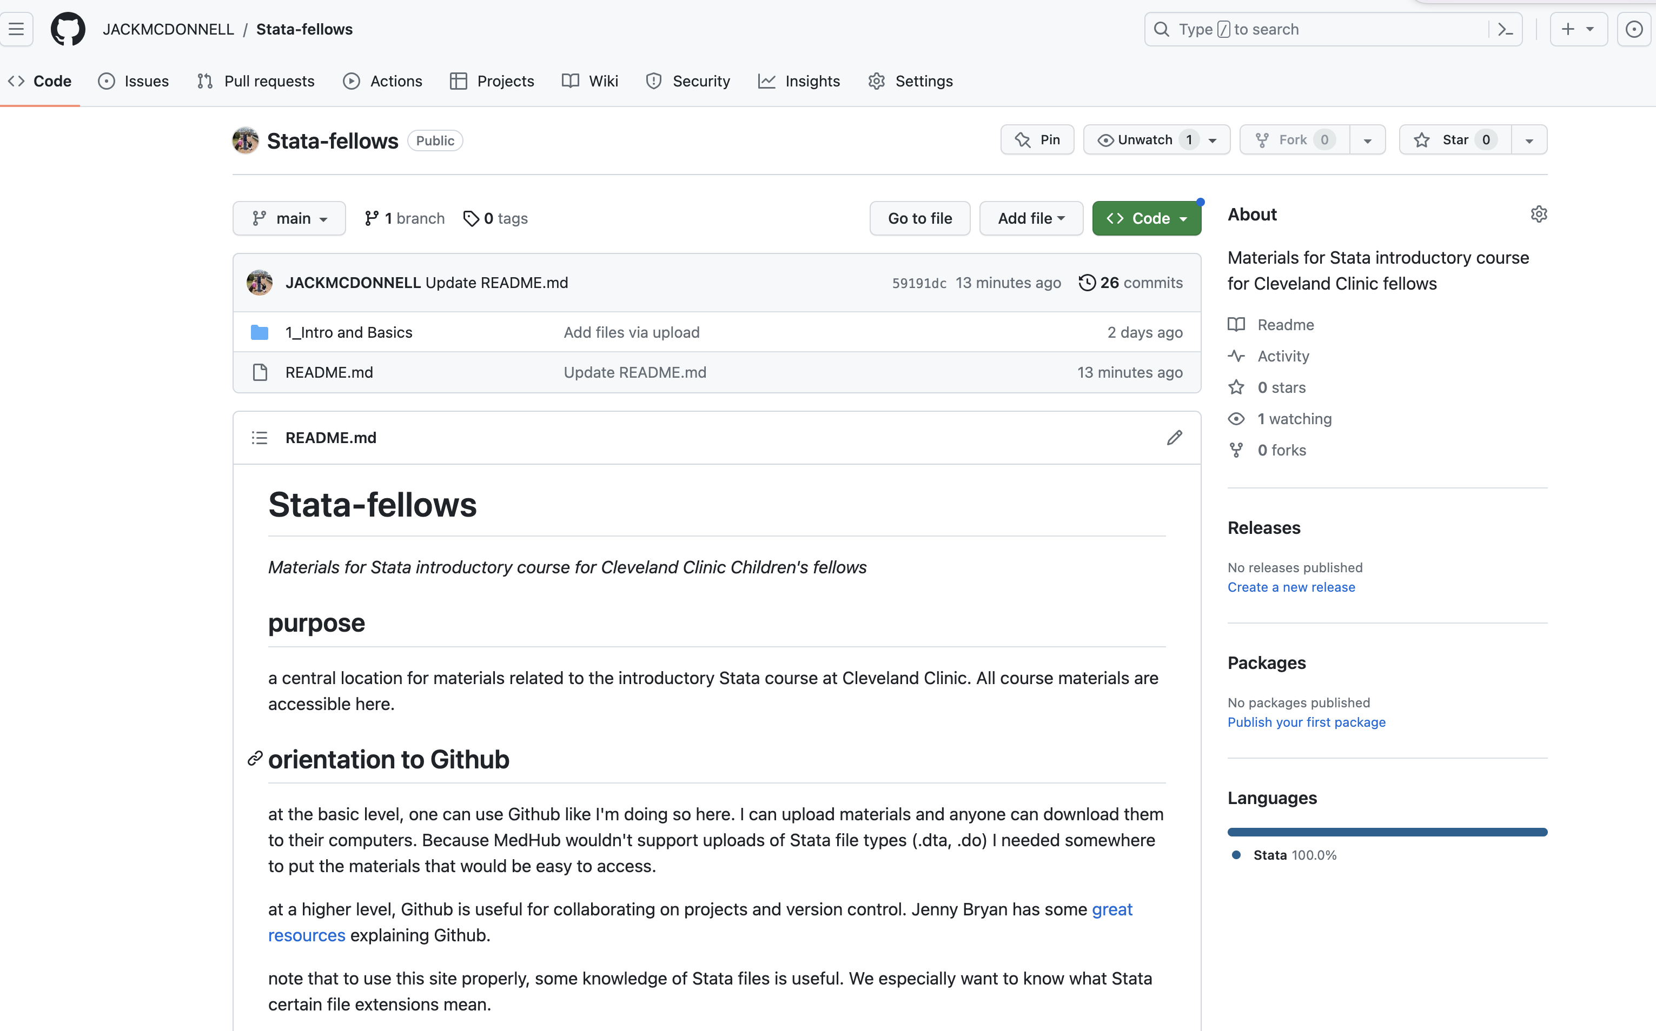

Slide 7
Now, for some live training . . .

